Slide 1

TO OUR PRESENTATION
WELCOME
GROUP NO. 2
KASHISH – 1222043011015
JANNAT – 1222043011023
ANJALI – 1222043011025

Slide 2
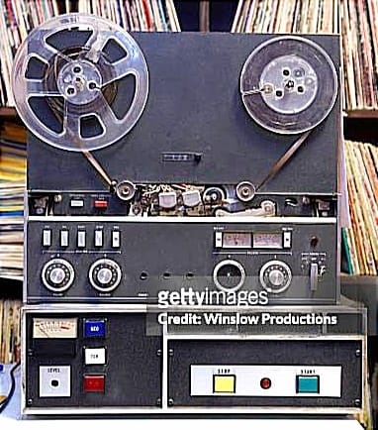
Index
Magnetic Tape
Characteristics
Mechanism
Read/write Head Assembly
Blocking and Deblocking
Tape utilization
Size of block
Beginning and end of the tape
Header and trailer labels
Applications
Advantages
Disadvantages

Slide 3

MAGNETIC TAPE
Magnetic tape is a storage medium that uses a thin, magnetizable strip of plastic film to store digital data. Data is encoded onto the tape using magnetic impulses, allowing for the storage and retrieval of information.
Magnetic tape is commonly used for backup, archival, and long-term storage purposes due to its relatively low cost and high capacity.
This Photo by Unknown Author is licensed under CC BY

Slide 4
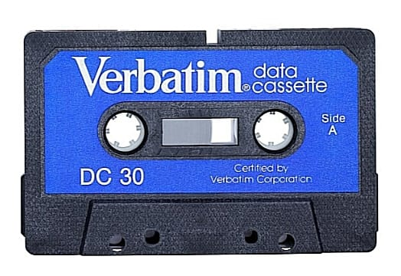
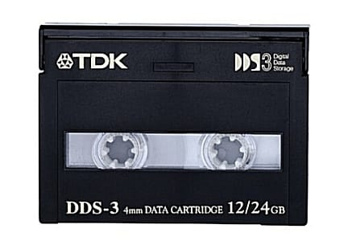
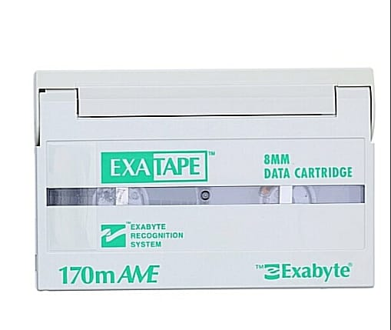
Characteristics
Used for large data storage.
Made up of plastic ribbon.
½” in width and 2400 feet in length.
Coated with magnetizable material on one side.
Data is stored in magnetized bits, which is permanent.
Data stored on tape can be read again and again from tape like sound tape recorder.
It is a sequential access memory.

Slide 5
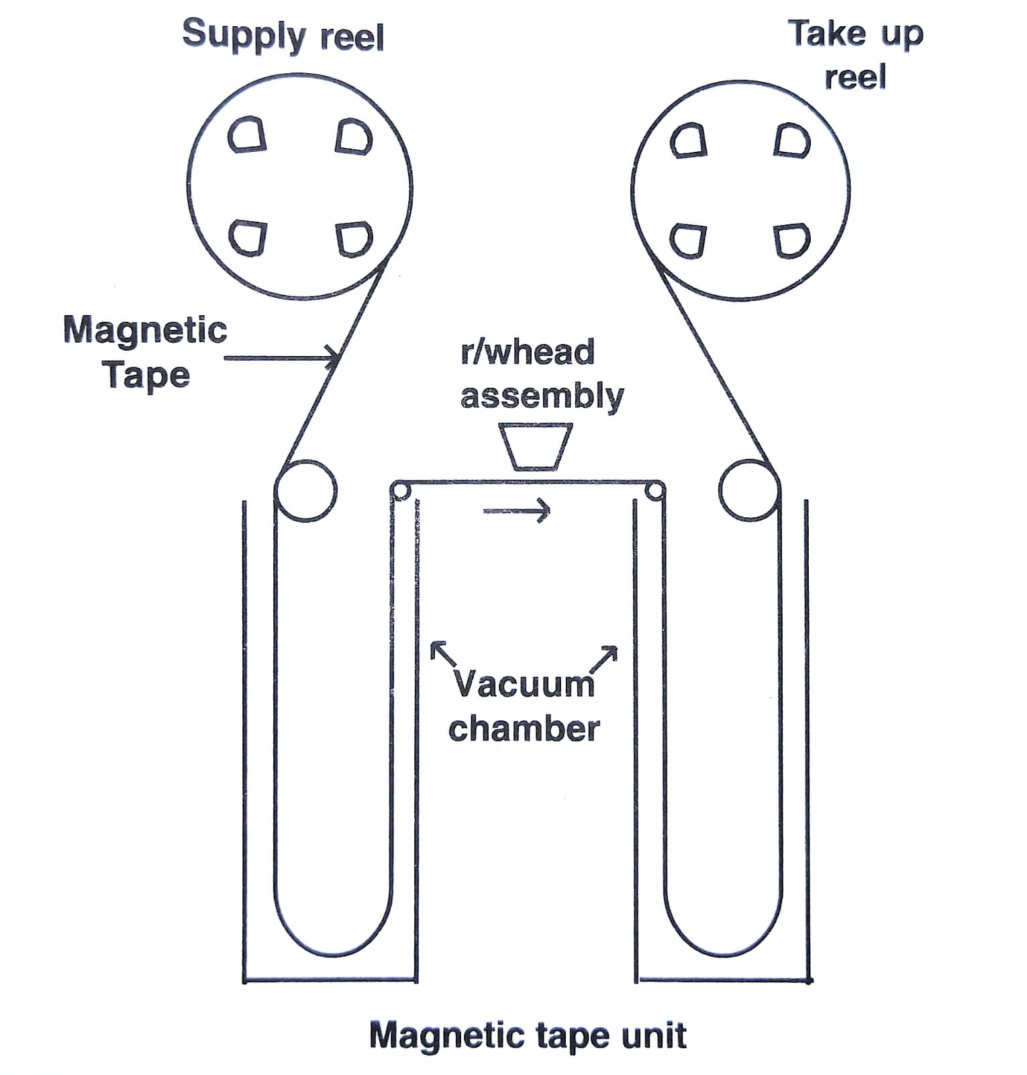

Mechanism of Magnetic tape

Slide 6
Tape density : the number of characters that can be recorded in one inch of tape.
Mostly tapes are of 9-tracks tapes i.e. it has 9 rows.
8 bits are encoded with character are recorded simultaneously on eight tracks of tape vertically.
9th track are parity bit and are used for controlling errors.
9- channel tape : there are 9 read/write heads i.e. for each track there is separate head in the r/w assembly.

Slide 7
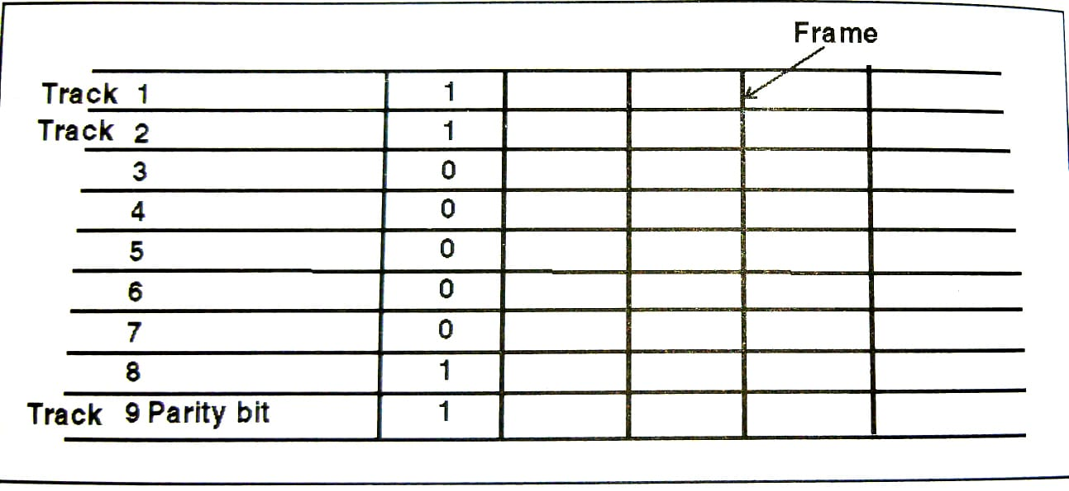
Read/write Head Assembly
Number of rows (horizontal) called Tracks and columns (vertical) called Frames.

Slide 8
Blocking and Deblocking
Blocking : The process of Grouping two or more records together is called blocking.
Deblocking : the process of extracting data from blocks is called deblocking.
Need :
Data is stored on the tape in the form of blocks. When a block is being read, tape moves with constant speed. When data is processed, no data should be read from the tape i.e. the tape should stop moving. The tape which is moving at a constant speed for reading, can not stop suddenly.
Similarly, if it is not moving, it can’t start moving immediately for reading data.
Therefore, a small length of tape is left blank between two blocks of data, so that alternately, the tape moves with constant speed, deaccelerates and then stops, it again starts, accelerates, moves with constant speed and so on.

Slide 9
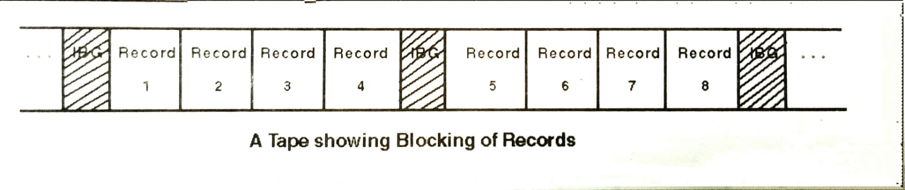
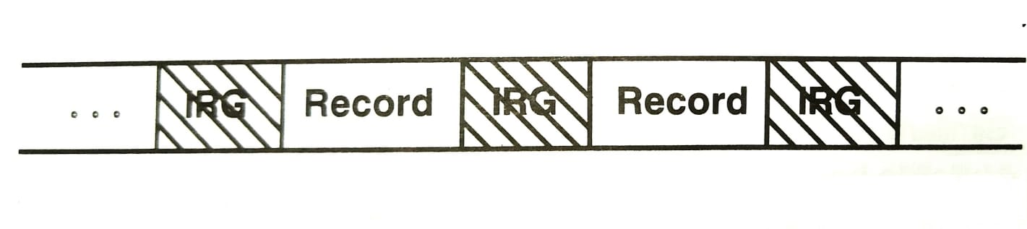
The blank portion of the tape between two blocks is called inter block gap(IBG).
A block is the smallest amount of data that can be transferred between the tape and the memory in one access.
A block can contain one or more logical records.
Number of records in a block is called blocking factor.
If the system stores only one record per block, the storage is called an unblocked and inter block gap(IBG) is termed as inter record gap(IRG).

Slide 10

Tape Utilization
Capacity Utilization : this refers to how effectively the available storage capacity of the tape is used. Effective utilization involves maximizing the amount of data stored on the tape without wasting space.
Compression : compression techniques can be employed to increase the amount of data that can be stored on a tape. Effective compression algorithms reduce the amount of physical space required for storing a given amount of data.
Data Organization : proper organization of data on the tape can improve utilization. For example, arranging data in sequential order can minimize the need for tape movement during read and write operations, thereby improving access times and efficiency.
File management : effective file management systems ensure that data is stored in a manner that optimizes tape utilization. This include techniques such as grouping related files together and minimizing fragmentation.
Backup strategies : tape utilization is closely tied to backup strategies. Employing incremental or differential backup techniques can optimize tape usage by only storing changed or new data since the last backup, rather than duplicating entire datasets.

Slide 11
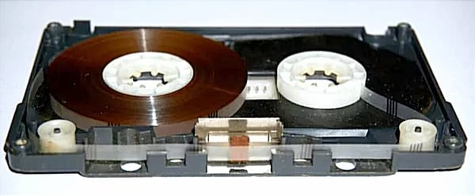
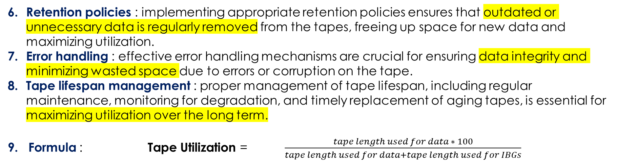
Retention policies : implementing appropriate retention policies ensures that outdated or unnecessary data is regularly removed from the tapes, freeing up space for new data and maximizing utilization.
Error handling : effective error handling mechanisms are crucial for ensuring data integrity and minimizing wasted space due to errors or corruption on the tape.
Tape lifespan management : proper management of tape lifespan, including regular maintenance, monitoring for degradation, and timely replacement of aging tapes, is essential for maximizing utilization over the long term.
9. Formula : Tape Utilization = $\frac{tape length used for data ∗ 100}{tape length used for data+tape length used for IBGs}$

Slide 12
Size of block
Fixed vs. Variable block size : some tape formats supports fixed-size blocks, where each block of data occupies a predetermined amount of space on the tape. In contrast, other formats allow for variable block sizes, where the size of each block can vary based on the size of the data being written .
Optimization for performance : the block size chosen for magnetic tape storage can have implications for performance. Larger block sizes may result in faster data transfer rates, especially for sequential access patterns, as large amounts of data can be read or written in each operation. However, smaller block sizes may be more suitable for random access patterns or when storing small files, as they reduce the amount of data that needs to be read or written in each operation.
Tape format and standards : different magnetic tape formats and standards may specify recommended or required block sizes. For example, Linear Tape-Open(LTO) technology, one of the most common tape formats, supports variable block sizes ranging from 512 bytes to 256 KB.

Slide 13

Application Requirements : the block size used in magnetic tape storage may be determined by the requires of the application or system using the tape. For example, database systems or backup software may have specific recommendations or requirement regarding block size for optimal performance.
Compression considerations : if data compression is used with magnetic tape storage, the effective block size may be influenced by the compression algorithm and the characteristics of the data being compressed. Smaller block sizes may result in less effective compression due to reduced opportunities for identifying redundant patterns within the data.
Trade-offs : choosing the appropriate block size involves trade-offs between factors such as performance, storage efficiency and compatibility with existing systems and applications. It may require careful consideration and testing to determine the optimal block size for a particular use case.

Slide 14
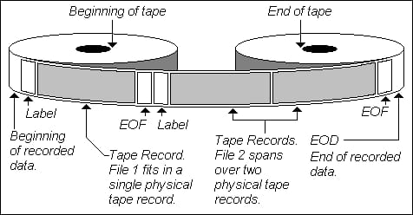
Beginning and end of the tape
Beginning of tape(BOT) :
The BOT is the physical start of the reel.
It serves as a reference point for the tape drive to locate the start of data during read ad write operations.
BOT typically contains information such as tape format, density, and other configuration parameters necessary for the tape drive to operate correctly.
Many tape formats include a specific marker or pattern on the tape to indicate the BOT.
End of the tape(EOT) :
The EOT marks the physical end of the tape reel.
When the tape drive reaches the EOT during a read operation, it indicates that there is no more data to be read from the tape.
During a write operation, reaching the EOT may trigger actions such as tape rewinding or switching to another tape if a multi-volume backup is being performed.

Slide 15
Header and trailer labels
Header labels :
Header labels are meta data blocks located at beginning of logical data sets or files on the tape.
They contain information such as name, creation date, size and other attributes.
Header labels help the tape drive or backup software identify and manage individual data sets or files stored on the tape.
Depending on the tape format, header label may also include checksums or other error detection/ correction information to ensure data integrity.
2. Trailer labels :
Trailer labels are similar to header labels but are located at the end of logical data sets or files on the tape.
They often contain meta data confirming the end of a data set or file, along with any necessary checksums or error correction information.
Trailer labels provide a way for the tape drive or backup software to verify the completeness and integrity of data sets and files during read operations.

Slide 16

Applications of magnetic tape
Data storage : magnetic tape store large amounts of data cost-effectively.
Backup and recovery : they’re used for backing up and restoring data in case of emergencies.
Archiving : magnetic tapes preserves historical scientific and cultural records efficiently.
Media production : they’re employed for recording and editing audio and video content.
Surveillance systems : used in security systems for continuous video recording.
Scientific research : magnetic tape store experimental data and simulations for research purposes.
Music recording : magnetic tape was historically used in cassette tapes for storing music albums.

Slide 17

Education : magnetic tapes were once used in educational settings for recordings of lectures and lessons.
Automated systems : magnetic tapes are sometimes used in automated manufacturing processes for guided robots or machinery.

Slide 18
Advantages
Cost – effective : magnetic tape offers a low cost storage solution compared to other mediums like solid-state drives(SSDs) or hard disk drive (HDDs).
High capacity : it can store large volumes of data, making it suitable for archival purposes and long term storage needs.
Durability : magnetic tapes are robust and resistant to physical damage, ensuring data integrity over time.
Longevity : tapes have a long shelf life, making them ideal for storing data for extended periods without degradation.
Reliability : they have a proven track record of reliability, with minimal risk of data loss or corruption.

Slide 19


Scalability : magnetic tape systems can easily scale to accommodate growing data storage requirements by adding more tapes or drives.
Fast data transfer : modern tape systems offer high data transfer speeds, facilitating efficient backup and data retrieval processes.

Slide 20

Disadvantages
Slower access : retrieving data can be slower compared to other storage methods.
Fragile : tapes can be damaged by mishandling or environmental factors.
Limited lifespan : overtime, tapes degrade and may become unusable.
Physical space : requires physical storage space for housing tapes.
Not ideal for random access : accessing specific data points can be time consuming.
Susceptible to magnetic fields : exposure to magnets can corrupt data.
Maintenance needed : tapes require periodic maintenance to ensure reliability.
Compatibility issues : older tapes may not be compatible with newer hardware.

Slide 21


Thank you
Let’s dive in

